Slide 1

AK-47
The Automatic Kalashnikov 1947 (AK-47 Rifle)

Slide 2
Introduction

Slide 3
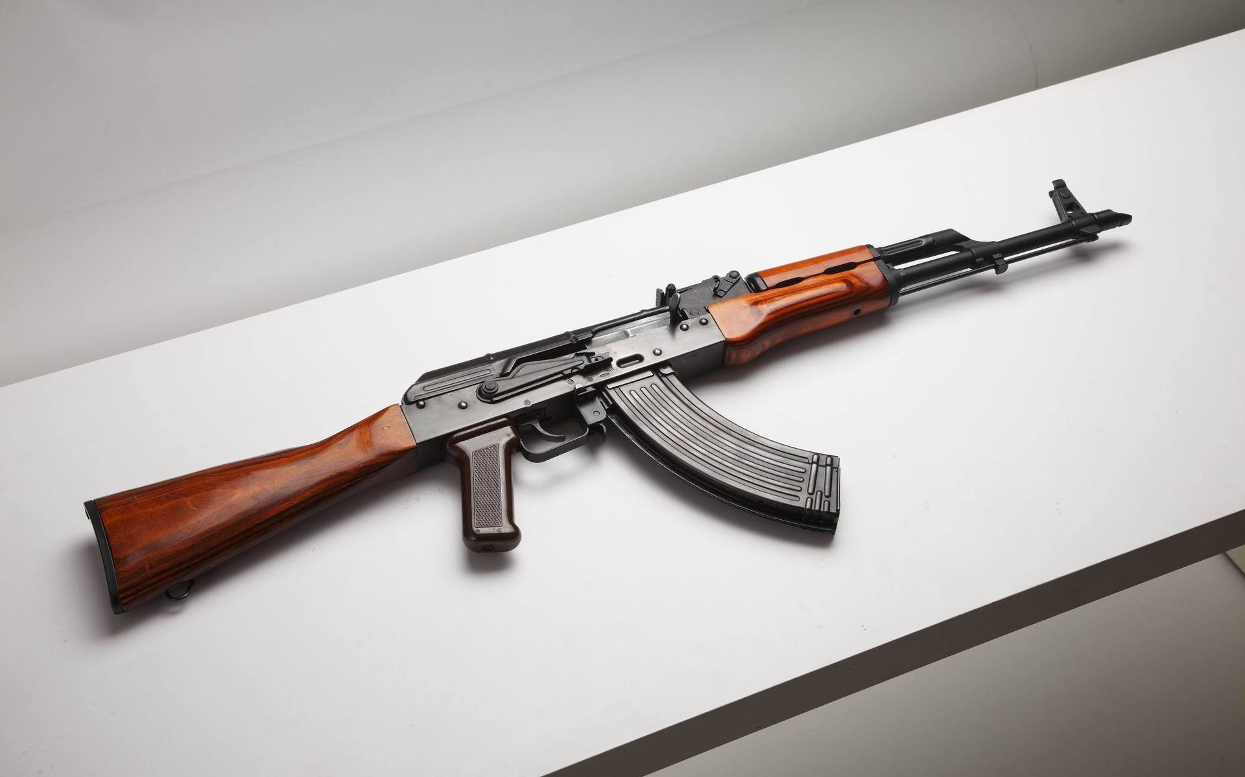
How many of you know this thing?

Slide 4

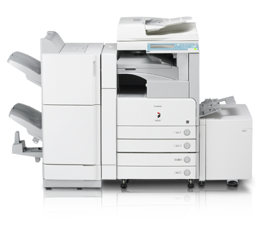
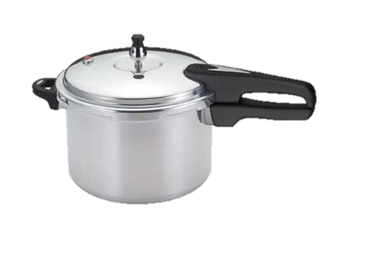
CAR
Photocopy Machine
Pressure Cooker.

Slide 5

Why ak-47 is so popular?
Cheap.
Reliable.
Durability.
Simple in design.
Easy to use.
Easy to repair.
Popularity.

Slide 6
A Quote from Kalashnikov.
“I was in the hospital, and a soldier in the bed beside me asked: ‘Why do our soldiers have only one rifle for two or three of our men, when the Germans have automatics?’ So I designed one. I was a soldier, and I created a machine gun for a soldier. It was called an Avtomat Kalashnikova, the automatic weapon of Kalashnikov—AK—and it carried the date of its first manufacture, 1947."

Slide 7
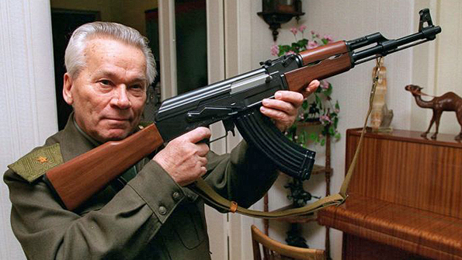
Background.
Mikhail Kalashnikov is the designer of AK-47. He was a Sargent in soviet army.
He started his designing career in 1941.
He decided to design an automatic rifle combining the best features of the American M1 and the German StG44.
Design of AK – 47 began in the last year of WWII 1945 till 1947 and was accepted by USSR in 1949.
It’s been 68 years and It is still in use.

Slide 8
Some Other Facts.
Kalashnikov didn’t earned a single penny out of the production.
He was at hospital when the design came up into his mind.
There are more Illegal AK-47 than legal documented because of easy manufacturing.
It is the most favorite weapon of terrorists.
For that Kalashnikov is uneasy. But it’s not his fault. He stated ''I created a weapon to defend the borders of my motherland. It's not my fault that it's being used where it shouldn't be.”
One of the main reason why America lost Vietnam war was AK-47.

Slide 9
Evolution Of
AK-47

Slide 10
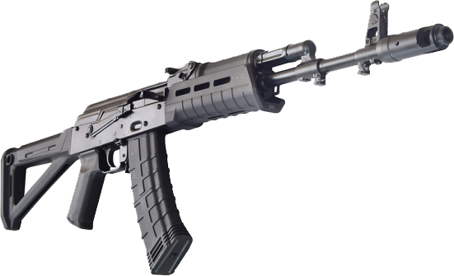

Fig: AK-74
Fig: AKM

Slide 11
Start of thinking.
About AK-47 Cartridge
Gathering ideas and making of new pitch
Replacement of AK-47

Slide 12
Anatomy

Slide 13
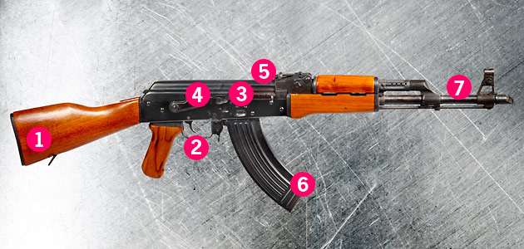
Various Parts of AK-47

Slide 14
AK-47 has seven vital parts. They are:
Stock
Trigger
Receiver
Selector Switch
Gas Piston
Magazine
Protective Coating

Slide 15

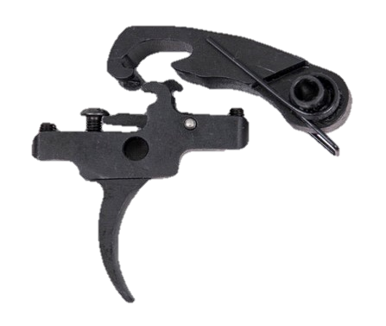
Stock: For holding the rifle.
Trigger: A mechanism to start Firing

Slide 16
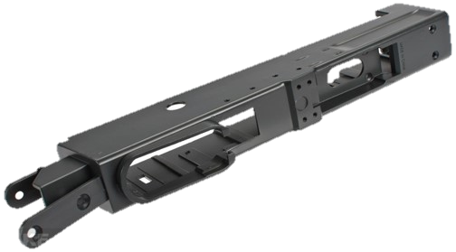
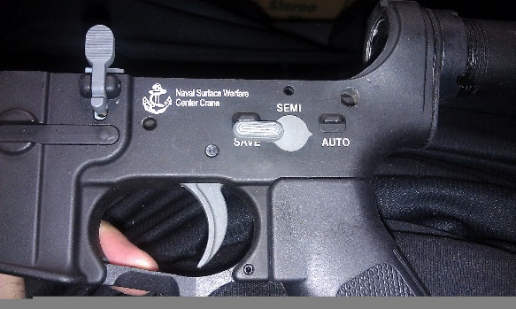
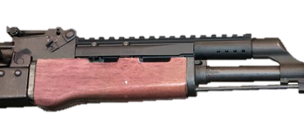
Receiver: houses the operating parts.
Selector Switch: The selector Switch is an option for switching between various fire methods.
Gas Piston: Reloads the rifle with high pressured GAS

Slide 17
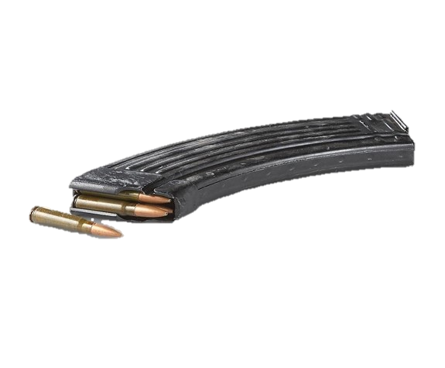
Magazine: A magazine is an ammunition storage
Protective Coating: For increasing reliability and protect from rust

Slide 18
Other common parts.
Pistol Grip: For holding the rifle without stock.
Charging handle: For cocking the rifle.
Front and Rear sight: For targeting.

Slide 19
Firing Mechanism of an AK47

Slide 20
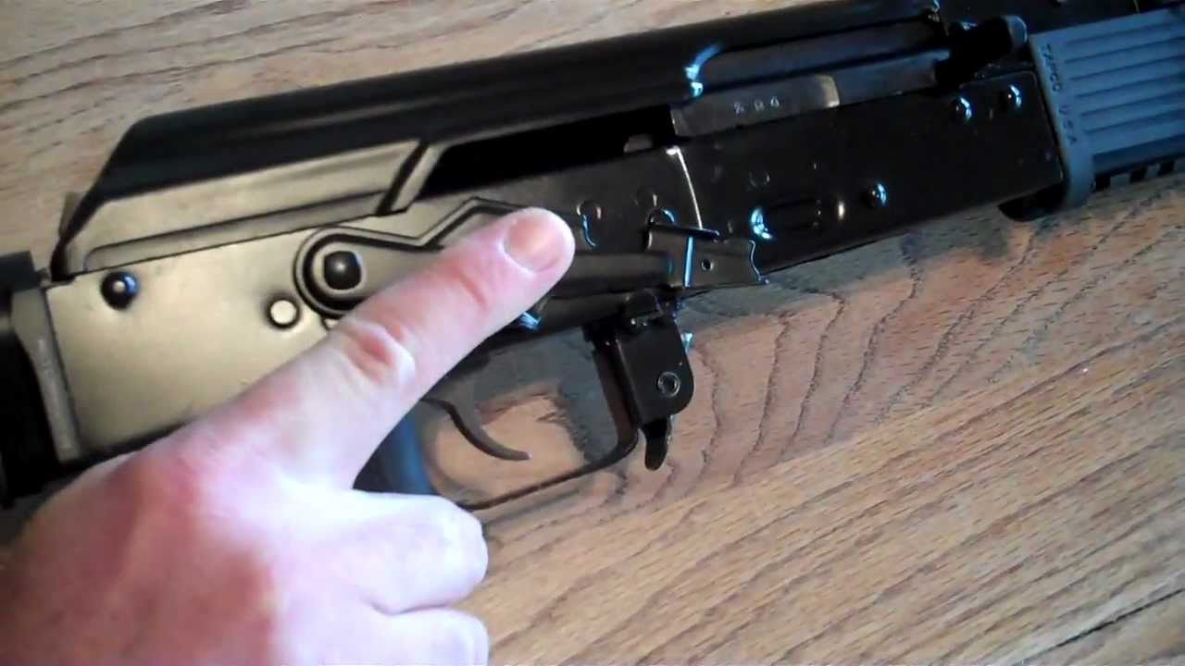
Firing modes of AK47
Automatic
Semi-automatic

Slide 21
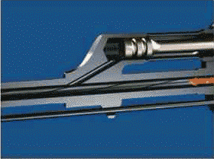
How does it fire a bullet?
When we pull the trigger a metal hammer hits the bullet barrel with enough momentum.
When the hammer hits the barrel the bullet and the containing shell detaches.
By the time the bullet detaches, the hammer gives it enough momentum to achieve the high velocity and proceed towards the target with high speed.
The blank shell stays attached to the gas piston.

Slide 22
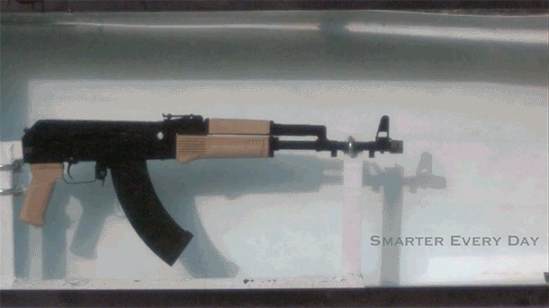
How does it reload automatically?
When the trigger is pulled, the gas chamber releases gas into the firing hole.
The hammer hits the metal bullet barrel and creates fire sparks.
Fire sparks ignite the gas and because of the expansion of the gas, the gas piston hits the empty bullet shell and throws it outside.
The barrel locking hatch takes another bullet from the magazine and locks it into the firing hole for the next round.

Slide 23

Difference between automatic and semi-automatic
Automatic
An automatic AK47 keeps firing and repeating the reloading process as long as the trigger is pulled.
Semi-Automatic
• In the semi-automatic mode, the user has to pull the trigger each time to fire a round.

Slide 24
Advantages &
Disadvantages

Slide 25

Advantages
Has been used in all forms of warfare like, climate & terrain
Components are designed to function effectively.
Most used in battlefield
Also used in anti aircraft weapon
Most effective against helicopter...
Offer good penetration thought door, walls, floor, etc.
Very effective against auto Mobile bodies...

Slide 26
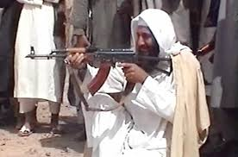
Disadvantages
Comparatively short range & poor accuracy.
The AKs barrel is also relatively light..
Also not known for tight shot groups at moderate ranges.
Has been used by various criminals.

Slide 27
Conclusion

Slide 28
Conclusion
Difficult challenge while there are weapons vying to replaced the AK.
China is the largest users of AK47
AK type rifles will remain in use within the people liberation army for quite sometime.
Always room for minor design, improvement, new features, techniques, material scan be incorporated to further improve the weapon.

Slide 29
Thank You!
A Project By Group Galileo
Hafizur Rahman Arfin (161-15-7144)
Md. Abu Sayeed (161-15-6769)
Sourav Das (161-15-7243)
Mushfiqus Salehin (161-15-7056)
Ankan Lahiri (161-15-7074)

